Slide 1
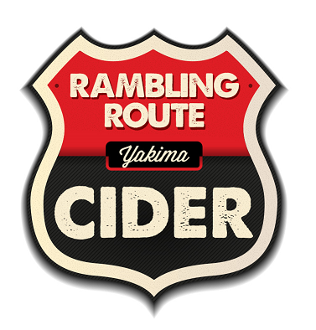
Rambling route cider
Adventurous cider!
Notes:
Notes: Just mad enough to sell ? – or – One bad bushel – or – Distribution is no accident! – Frantic execution/Furious distribution

Slide 2
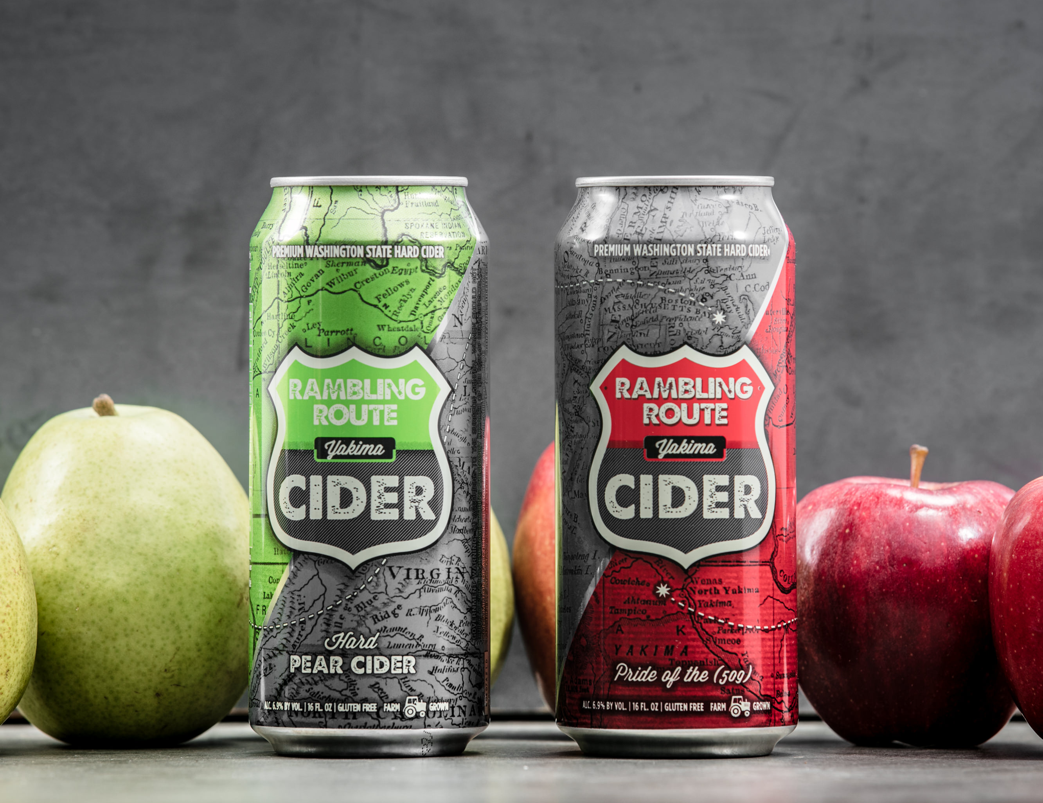
Our story
The apple’s journey to America...
…was parallel to man’s. The boat landed and the exploration began: in this vast new land the choices for thriving were endless. Some were happy to live on the coast where they landed, spreading out and staying diverse. Others were content to live amongst a few or be a solo tree in a town square. A few made it halfway across the land and settled in. The fearless joined the westward migration on horses and wagons, traveling thousands of miles looking for the perfect dirt, long sunny days and ample water. When it reached the land that would be called Washington, the apple knew. It was home at the end of a Rambling Route.

Slide 3
DUBBED AS A HEALTHIER DRINK…
Many “commercial” cider producers boast of health benefits associated with the apple. With the term “gluten free” taking flight across the country, consumers are now looking to hard apple cider as the newest way to enjoy a cocktail while separating themselves from this protein deposit found in wheat and related grains, including barley and rye.
But what about other ingredients less talked about, like malic acid, glucose-fructose, UNIDENTIFIED natural flavoring and coloring, and Sodium Metabisulfite?
Plain and simple, true “artisan” cider starts with authentic bitter-sharp and bitter –sweet apple varietals. There’s no need for these other additives and preservatives if you are truly producing a craft hard apple cider.
COMMERCIAL CIDER VERSUS ARTISAN CIDER
DON’T BE DUPPED!

Slide 4
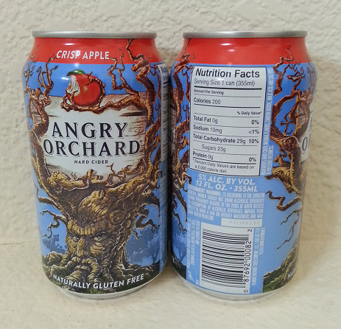
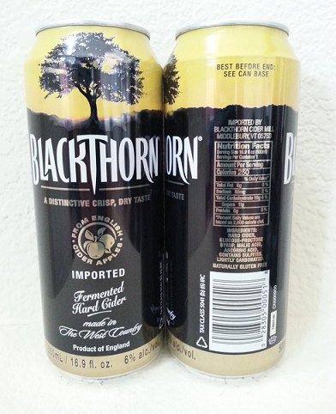
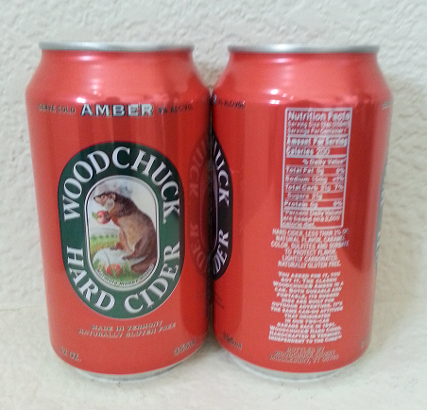
YOU ARE WHAT YOU DRINK…
ANGRY ORCHARD
BLACKTHORN
WOOD CHUCK
HARD CIDER, NATURAL FLAVORS, CARBON DIOXIDE, MALIC ACID AND SULFITES TO PRESERVE FRESHNESS.
HARD CIDER, GLUCOSE-FRUCTOSE, SYRUP, MALIC ACID, CONTAINS SULFITES, NATURALLY CARBONATED.
HARD CIDER, NATRUAL FLAVOR, CARAMEL COLOR, SULFITES AND SORBATE, TO PROTECT FLAVOR.

Slide 5
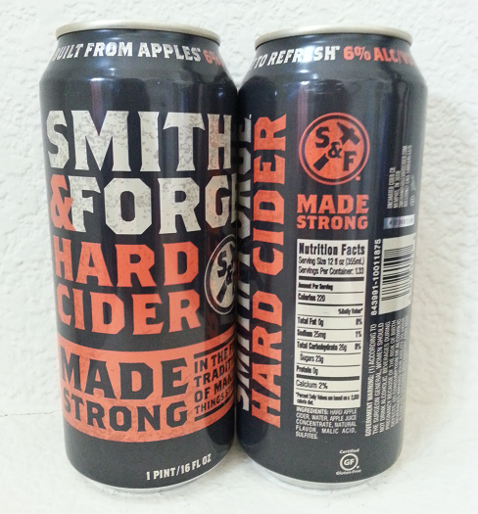
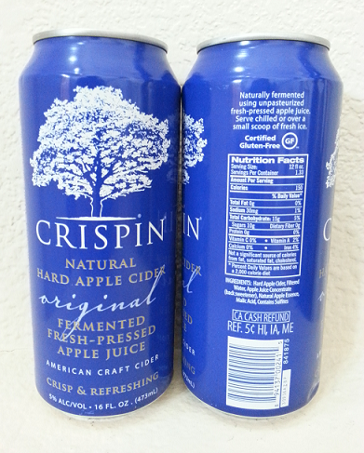
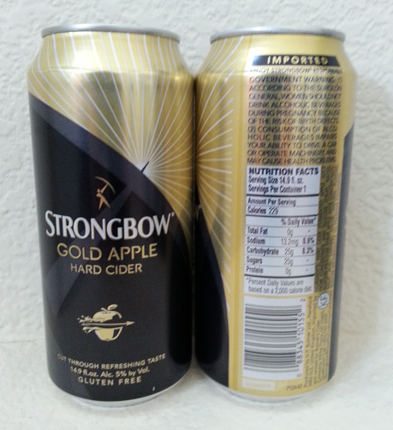
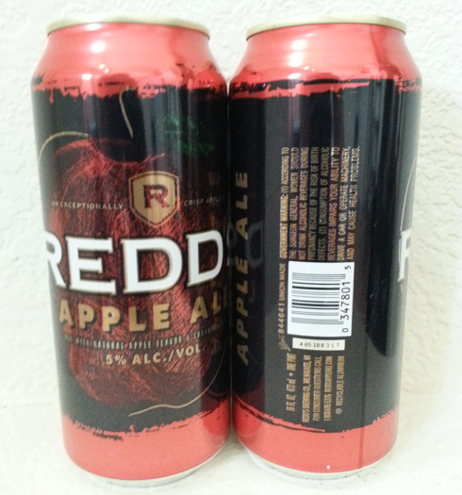
SMITH & FORGE
CRISPIN
STRONGBOW
REDD’S APPLE ALE
HARD APPLE CIDER, WATER, APPLE JUICE CONCENTRATE, NATURAL FLAVOR, MALIC ACID, SULFITES.
HARD APPLE CIDER, FILTERED WATER, APPLE JUICE CONCENTRATE, (BACK SWEETNER), NATURAL APPLE ESSENCE,MALIC ACID, CONTAINS SULFITES.
HARD CIDER(FERMENTED APPLE JUICE FROM CONCENTRATE AND GLUCOSE SYRUP), WATER, GLUCOSE-FRUCTOSE SYRUP, APPLE JUICE CONCENTRATE, MALIC ACID, CARAMEL COLOR, NATURAL FLAVORS, SODIUM METABISULFITE TO PRSERVE FRESHNESS.
ALE WITH NATURAL APPLE FLAVOR & CARAMEL COLOR.

Slide 6
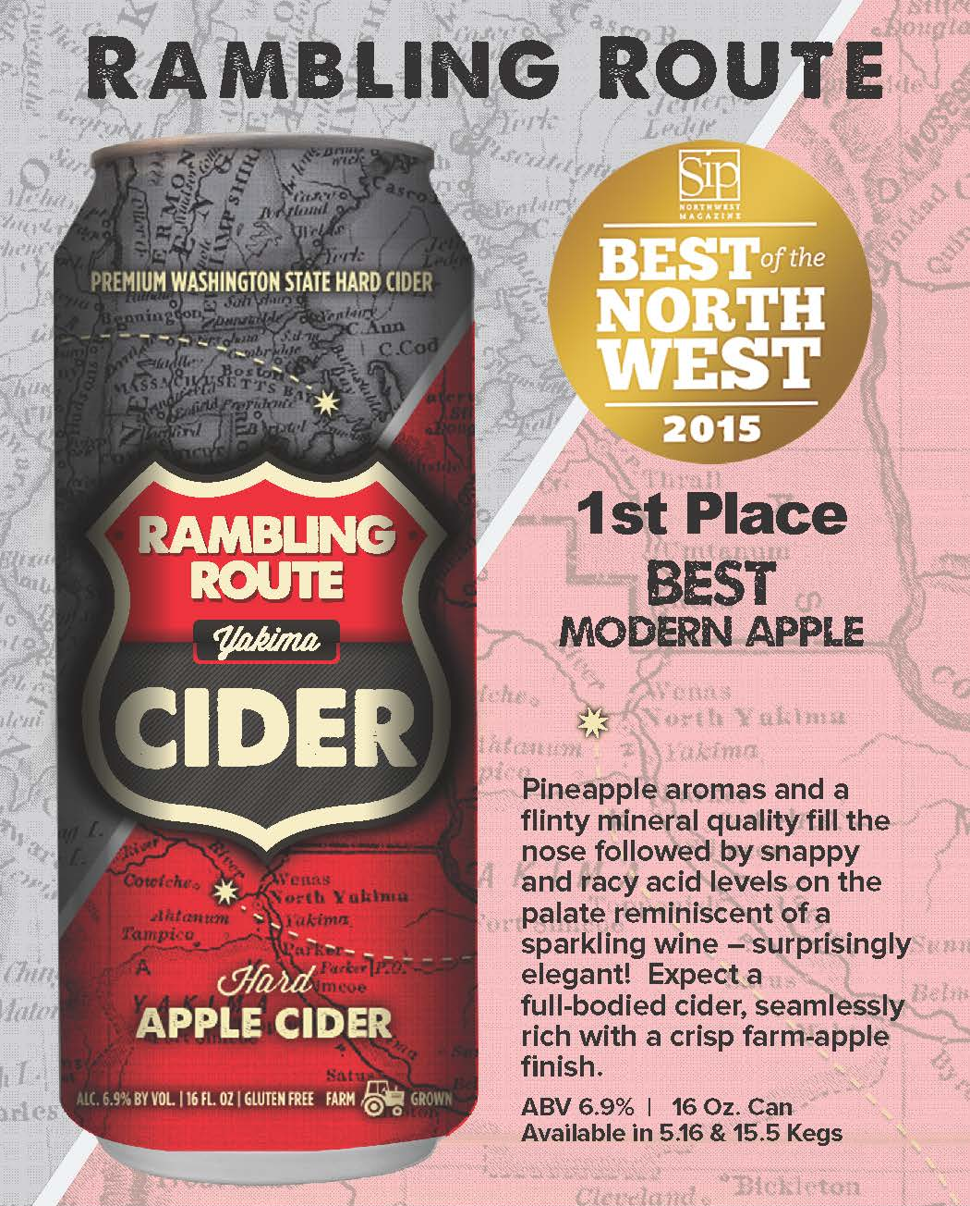
What’s in rambling route?
Apples!
And a proprietary yeast.
ABV 6.9% / 16 oz Cans
Available in 5.16 & 15.5 Kegs

Slide 7
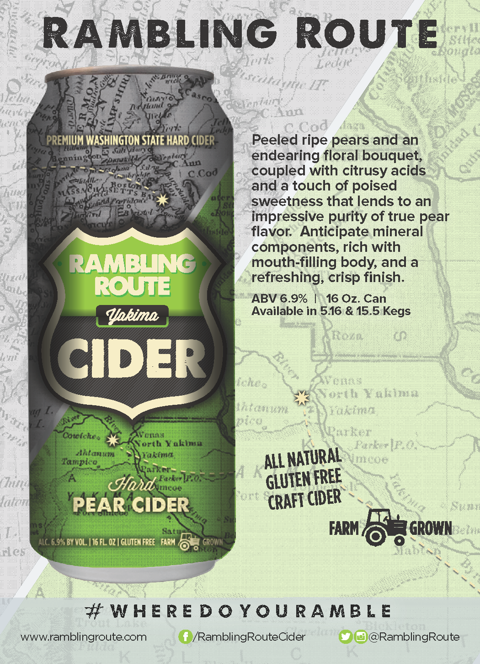
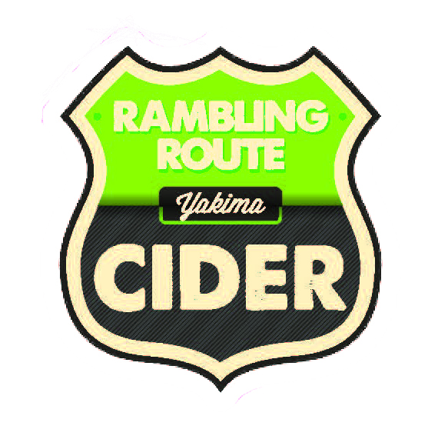
Rambling Route PEAR
Apple & Pear
A Pearfect Combination!.
ABV 6.9% / 16 oz Cans
Available in 5.16 & 15.5 Kegs
Released May 2016.

Slide 8
Rambling route Advantages…
• The Campbell Family has been planting and growing apples in Washington since the 1920’s.
• Organic farming practices have been utilized for over 25 years.
• We are the largest grower of bitter-sharp and bitter-sweet apples in the country, with over 40 varieties planted.
• We grow our apples, cherries, apricots, and Perry pears.
• We produce our ciders at our own cidery, handling every step of the process from tree to can.
• Our products are “farm grown,” with no additives or preservatives added.
KEY Relationships with platinum properties
Personal relationships with las vegas wine community
Keen understanding of property protocol(s)
Distributor & supplier expertise
Business plan development & execution
forward thinking, no push-back!
Social media mastery

Slide 9
Our story
From branch to can…
For those that appreciate the bold, crisp flavor of biting into a Washington grown apple, your quest for the perfect apple cider ends with Rambling Route. We grow and press only fresh apples from our family farm and carefully blend under the roof of our own cidery located in the heart of the Yakima Valley. Expect pineapple aromas and mineral qualities on the nose, snappy and racy acid levels on the palate, coupled by a deep full-bodied finish. No additives, no concentrates, or preservatives – ever!

Slide 10
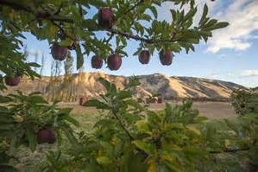
RAMBLING ROUTE
THANK YOU!
The journey has started!
RAMBLING ROUTE CIDER IS PART OF THE TIETON CIDER WORKS FAMILY OF HARD CIDER PRODUCTS.
Notes:
Notes: Just mad enough to sell ? – or – One bad bushel – or – Distribution is no accident! – Frantic execution/Furious distribution

